Slide 1
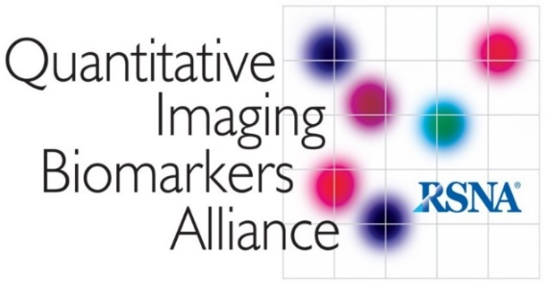
The Quantitative Imaging Biomarkers Alliance (QIBA®)
Edward F. Jackson, PhD – Chair, QIBA
Professor and Chair, Department of Medical Physics
University of Wisconsin School of Medicine & Public Health
Part II
July 22, 2016

Slide 2
RSNA QIBA Approach
Profile
Describes a specific performance claim and how it can be achieved.
Claims: tell a user what can be accomplished by following the Profile.
Details: tell a vendor what must be implemented in their product; tell a user what procedures are necessary.
Protocol
Describes how clinical trial subjects or patients should be imaged so as to achieve reproducible quantitative endpoints when those tests are performed utilizing systems that meet the specific performance claims stated in the QIBA Profiles.

Slide 3
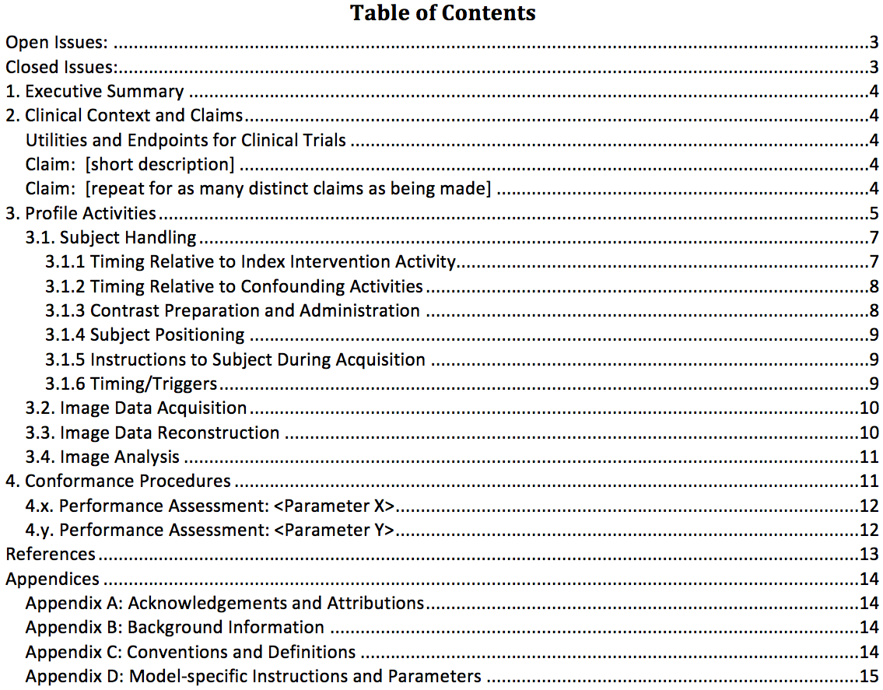
Profile Template
v2.2, April 2015

Slide 4
Example Claim Language
CROSS-SECTIONAL CLAIM Example: For a <QIB> measurement of X in solid tumors greater than Y cm in diameter or twice the section thickness (whichever is greater), a 95% confidence interval for the true <QIB> value is X ± <1.96*wSD>.
LONGITUDINAL CLAIM Example: A measured change in <QIB> of Z or larger indicates a true change has occurred with 95% confidence. For a measured change of Z, a 95% confidence interval for the true change is Z ± <1.96 * √2 * wSD>.

Slide 5
Profile Template
v2.2, April 2015

Slide 6
Profile Template
v2.2, April 2015

Slide 7
Profile Template
v2.2, April 2015

Slide 8
Profile Stages
Stage 1: Public Comment
Biomarker Committee experts have drafted the profile and believe it is practical and expect it to achieve the claimed performance.
Stage 2: Consensus
The wider community has read the profile and believe it to be practical and expect it to achieve the claimed performance.
Stage 3: Technically Confirmed
Sites (at least 2 and with at least 2 vendor platforms) have implemented the profile and found it to be practical and expect it to achieve the claimed performance.
Stage 4: Claim Confirmed
Sites (at least 2 and with at least 2 vendor platforms) have implemented the profile and found it achieved the claimed performance.
Stage 5: Clinically Confirmed
Many sites have implemented the profile and demonstrated the claimed performance is widely achievable.
http://qibawiki.rsna.org/index.php/QIBA_Profile_Stages

Slide 9
Who Forms QIBA?
Over 850 individuals have joined the QIBA effort, representing all major stakeholders in the quantitative imaging initiative:
Radiologists
Imaging scientists
Pharmaceutical companies
Imaging device companies
Imaging informatics and other software companies
Government agencies
Professional societies
Clinical trialists and clinicians
Statisticians and metrologists
297 individuals from over 100 companies, 20 from the FDA, 46 from government (excluding FDA)
Vast majority of stakeholder efforts are voluntary

Slide 10
QIBA Steering Committee
Jackson / Perlman
CT Coordinating Cmte
Goldmacher, Schwartz
CT Volumetry Biomarker Cmte
Goldmacher, Armato, Siegelman
Lung Density Biomarker Cmte
Lynch, Fain, Fuld
NM Coordinating Cmte
Wahl, Perlman
FDG-PET Biomarker Cmte
Sunderland, Subramaniam, Wollenweber
PET-Amyloid Biomarker Cmte
Smith, Minoshima, Perlman
MR Coordinating Cmte
Guimaraes, Zahlmann, Elsinger
PDF-MRI Biomarker Cmte
Rosen, Boss, Kirsch
fMRI Biomarker Cmte
Petrella, DeYoe, Reuss
US Coordinating Cmte
Hall, Garra
US SWS Biomarker Cmte
Hall, Garra, Milkowski
Process Cmte
O’Donnell, Sullivan
DW-MRI TF
Boss, Chenevert
DCE-MRI TF
Laue, Chung
DSC-MRI TF
Erickson, Wu
DTI TF
Provenzale, Schneider
Volumetry Algorithm Challenge TF
Athelogou
Profile Compliance TF
Turkington, Lodge, Boellaard
Airway Measurement TF
Fain
SPECT Biomarker Cmte
Seibyl, Mozley, Dewaraja
Clinical Applications TF
Samir, Cohen-Bacrie, Cosgrove
System Dependencies/ Phantom Testing TF
Palmeri, Wear
Small Lung Nodule TF
Gierada, Mulshine, Armato
QIBA/fNIH FDA Biomarker Qualification Partnership
QIBA/fNIH FDA Biomarker Qualification Partnership
QIDW Oversight Cmte
Erickson
MRE Biomarker Cmte
Cole, Ehman
fMRI Bias TF
Voyvodic
Fat Fraction Biomarker Cmte
Reeder, Sirlin
Clinical Literature Review TF
Image Acq & Processing for DaTscan TF
Phantoms & DRO TF
Quantitative Image Analysis TF
US Volume Flow Biomarker Cmte Fowlkes, Kripfgans
Contrast-Enhanced US
Averkiou, Barr
Past Chair/Ext Relations Liaison:
Daniel Sullivan
Program Advisor:
Kevin O’Donnell
Scientific Liaisons:
CT: Andrew Buckler
MR: Thomas Chenevert
NM: Paul Kinahan
US: Paul Carson
TF = Task Force
27-May-2016

Slide 11
NIBIB Groundwork Project Funding
Summary of NIBIB-funded groundwork projects (~$625K per round):
Round 1 (2011-12): N=16 – complete
Round 2 (2012-13): N=12 – complete
Round 3 (2013-14): N=13 – complete
Round 4 (2014-15): N=13 – complete
Round 5 (2015-16): N=12 – in progress
Round 6 (2016-17): TBD
HHSN268201000050C
HHSN268201300071C
HHSN268201500021C
Notes:
Rounds 1-4: Total of 54 projects

Slide 12
Current Profile Status
Publicly Reviewed and Posted*:
CT Tumor Volume Change (v2.2) for tumor response
FDG-PET/CT SUV as an Imaging Biomarker for Measuring Response to Cancer Therapy (v1.05)
DCE-MRI Quantification (v1.0) for tumor response
FDG-PET/CT Protocol (with summary published in JNM in April 2015)
In Final Stage of Development for Public Comment Phase:
CT Small Nodule Volumetry for lung cancer CT screening
CT Lung Densitometry for COPD
PET Amyloid for Alzheimer’s Disease
DW-MRI for tumor response
fMRI for pre-surgical planning
Ultrasound Shear Wave Speed for liver fibrosis
*www.rsna.org/qiba

Slide 13
Current Profile Status
In Development:
Revised CT Tumor Volume Change for liver lesions
Revised DCE-MRI to address 3T and parallel imaging
MR Diffusion Tensor Imaging (DTI) for traumatic brain injury
MR Elastography for liver fibrosis
Dynamic Susceptibility Contrast (DSC)-MRI for perfusion assessment in stroke
MR Proton Density Fat Fraction (PDFF) for liver disease
Ultrasound Volume Flow for perfusion studies
Contrast-Enhanced Ultrasound (CEUS) for perfusion studies
SPECT for brain diseases

Slide 14
Current Status
QIBA Metrology Working Group
Five manuscripts published in Statistical Methods for Medical Research in 2014.
One manuscript published in Radiology in 2015.
QIBA Deliverables Based on Groundwork Projects with NIBIB and RSNA Support
Profiles* + Protocols | Manuscripts | Presentations | Posters | Physical Phantoms | DROs | Software Apps | Datasets
3 + 1 | 31 | 35 | 25 | 3 | 5 | 4 | 5
As of May 20, 2016
*Publicly reviewed stage
Notes:
PubMed search: Five manuscripts, all from 2015, citing QIBA initiatives (from authors unaffiliated with QIBA). (As of 4/8/2016)

Slide 15
Adoption of QIBA Products / Concepts
Increasingly active imaging vendor representation on QIBA committees; senior NEMA/MITA, FDA, and NIST representation on QIBA Steering Committee
Marketing of PET/CT scanners now emphasizes quantitative ability, and marketing of such ability by other modalities is expected
QIBA Profiles adopted in whole or in part in clinical trials (Roche, Merck, ECOG-ACRIN)
QIBA approach has been endorsed at several conferences (e.g., IOM DTI workshop; NIST Workshop on Standards for Quantitative MR)
Requests for QIBA presentations at national / international meetings of scientific and professional organizations (e.g., AAPM 2015 Presidential Symposium, 2016 SPIE Plenary Symposium, 2016 ISMRM Plenary Symposium, 2016 75th Annual Meeting of the Japan Radiological Society, etc.)

Slide 16
Adoption of QIBA Products / Concepts
Adoption and marketing of “QIBA compliance” by some imaging core labs
Internationalization of QIBA:
Active participation from individuals in South America, Europe, and Asia
European Society of Radiology European Imaging Biomarker Alliance (EIBALL)
EORTC / IMI – QIBA collaboration (MR DWI)
Japan Radiological Society (“QIBA/Japan”)
São Paulo neuroradiology clinical trial adoption of QIBA profiles
Korean Society of Radiology participation

Slide 17
Current QIBA Challenges
Conformance certification
Establish formal processes for conformance certification.
Field tests / Implementation of QIBA Profiles
Field tests take time and money.
QIBA cannot currently fund human subject field tests using NIBIB funds.
Need to collaborate with other organizations to accomplish field testing, e.g., ECOG/ACRIN and other clinical trial (cooperative) groups, IMI/EORTC, etc.
Image datasets
Large sets of QIBA-conformant scans are needed to test algorithms, but there is still resistance to the concept of data sharing.
Sustainability
Need to seek additional sources of funds.

