Slide 1
QIBA SC Meeting Agenda
Welcome and Current Status
  Welcome to New SC Members
  Conflict of Interest Disclosures
  Review and Approval of the 5/23/2019 SC tcon summary
  QIBA Organization Chart

Slide 2

QIBA Steering Committee
Jackson / Guimaraes
CT Coordinating Cmte
Jarecha, Siegelman, Lynch
CT Volumetry Biomarker Cmte
Jarecha, Samei, Siegelman
Lung Density Biomarker Cmte
Lynch, Fain, Fuld
NM Coordinating Cmte
Wahl, Mozley, Smith
FDG-PET Biomarker Cmte
Sunderland, Subramaniam, Wollenweber
PET-Amyloid Biomarker Cmte
Smith, Minoshima, Matthews
MR Coordinating Cmte
Rosen, Zahlmann, Elsinger
fMRI Biomarker Cmte
Pillai, Mohamed, Soltysik
US Coordinating Cmte
Hall, Garra
US SWS Biomarker Cmte
Hall, Garra, Milkowski
Process Cmte
O’Donnell, Sullivan
DW-MRI Biomarker Cmte
Boss, Chenevert
DCE-MRI Biomarker Cmte
Laue, Chung
DSC-MRI Biomarker Cmte
Erickson, Wu
Volumetry Algorithm Challenge TF
Athelogou
Airway Measurement TF
Fain
Tc-99m Body: Oncology & Immunology Biomarker Cmte
Dewaraja, Miyaoka
Small Lung Nodule Biomarker Cmte
Gierada, Mulshine, Armato
QIBA/fNIH FDA Biomarker Qualification Partnership
QIBA/fNIH FDA Biomarker Qualification Partnership
QIDW Oversight Cmte
Erickson
MRE Biomarker Cmte
Cole, Ehman
fMRI Bias TF
Voyvodic
Proton Density Fat Fraction Biomarker Cmte
Reeder, Yokoo
Ioflupane / I-123 Brain / Neuropsych Biomaker Cmte
Seibyl, Dickson
US Volume Flow Biomarker Cmte
Fowlkes, Kripfgans, Jago
Contrast-Enhanced US Biomarker Cmte
Averkiou, Barr, Erpelding
ASL Biomarker Cmte (w/EIBALL)
Golay, Achten, Guenther
Sustainability Task Force
TBD
MSK Biomarker Cmte
Link, Li
MRE Profile-Writing TF
Cole, Ehman
CT Angiography Biomarker Cmte
Buckler, Saba, Schoepf
Representation from:
Academic radiology
Imaging science
Equipment industry
Software industry
Pharmaceutical industry
Imaging CROs
Regulatory (FDA)
Standards (NIST/MITA)
Statistics
External Relations Liaison:
Daniel Sullivan
Statistician:
Nancy Obuchowski
19 Biomarker Committees
4 Task Forces (TFs)
Scientific Liaisons:
CT: Andrew Buckler
MR: Thomas Chenevert
NM: Paul Kinahan
US: Paul Carson
Suspended
DTI Task Force
Schneider, Provenzale
14-August-2018

Slide 3
QIBA Deliverables (1)
Imaging Metrology – Consistent with International Vocabulary of Metrology (VIM)
  Five manuscripts in Statistical Methods for Medical Research (2015)*
  One manuscript in Radiology (Sullivan, et al. 2015)*
  One manuscript in Journal of the National Cancer Institute**
  Robust statistical framework for:
    Development of cross-sectional and longitudinal claims
    Conformance assessment with profile specifications
    Study design for clinical trials using QI biomarkers
  Developing statistical framework for:
    Multi-parametric measurands (needed for radiomics and other applications where a single measurand is inappropriate or insufficient)
*Available at www.rsna.org/qiba
** Obuchowski, et al. Statistical Considerations for Planning Clinical Trials with Quantitative Imaging Biomarkers, 2019

Slide 4

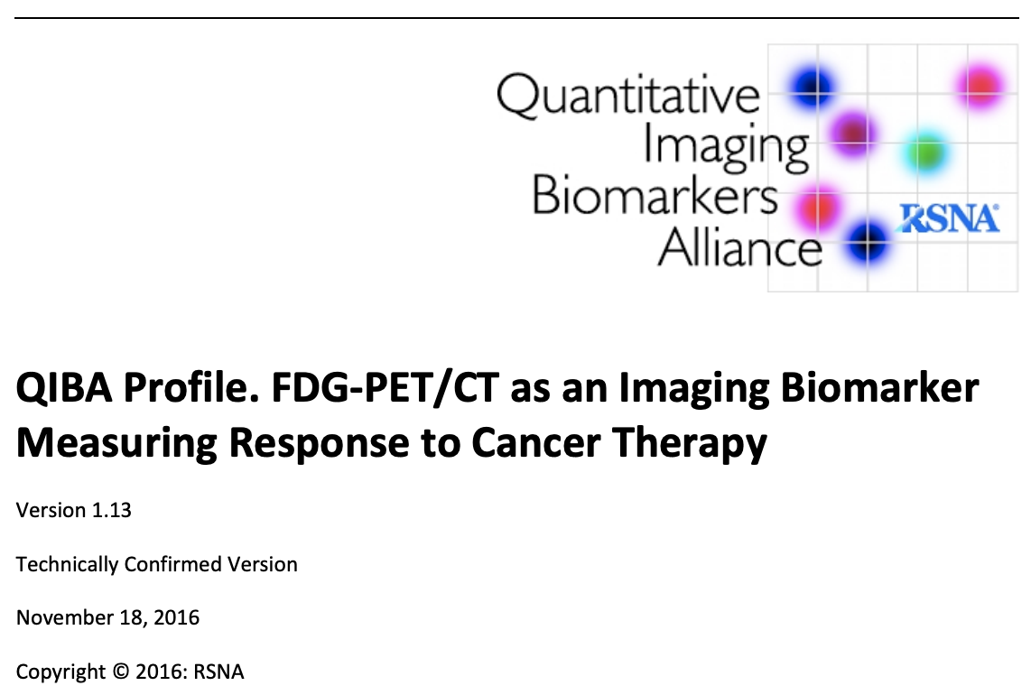
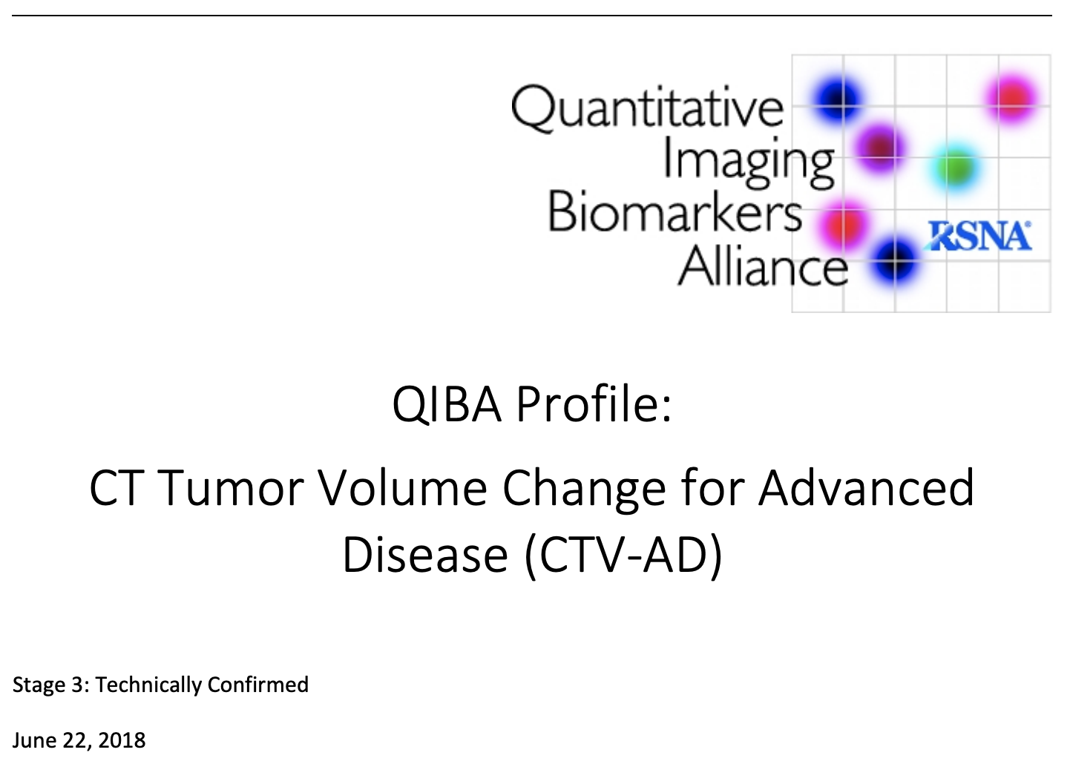
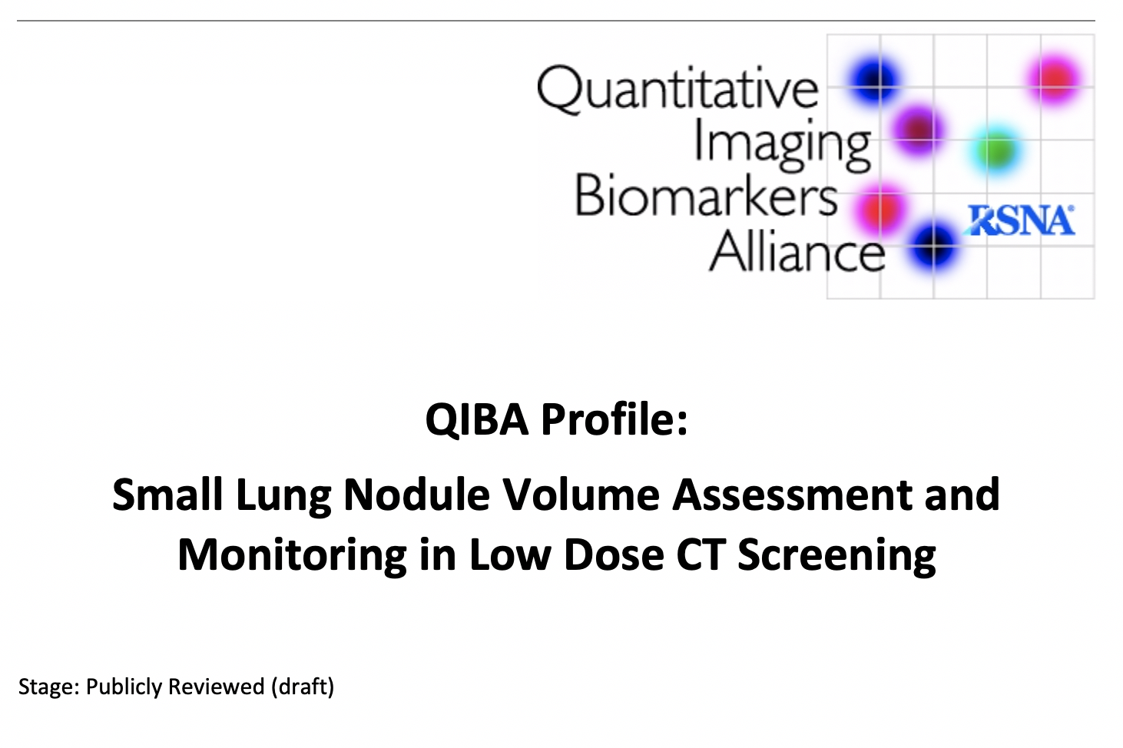
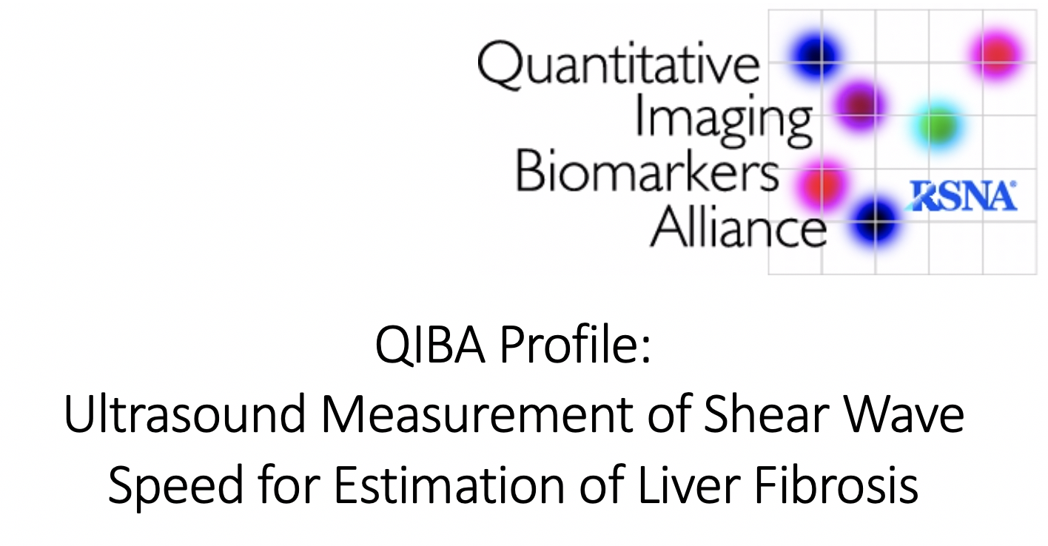
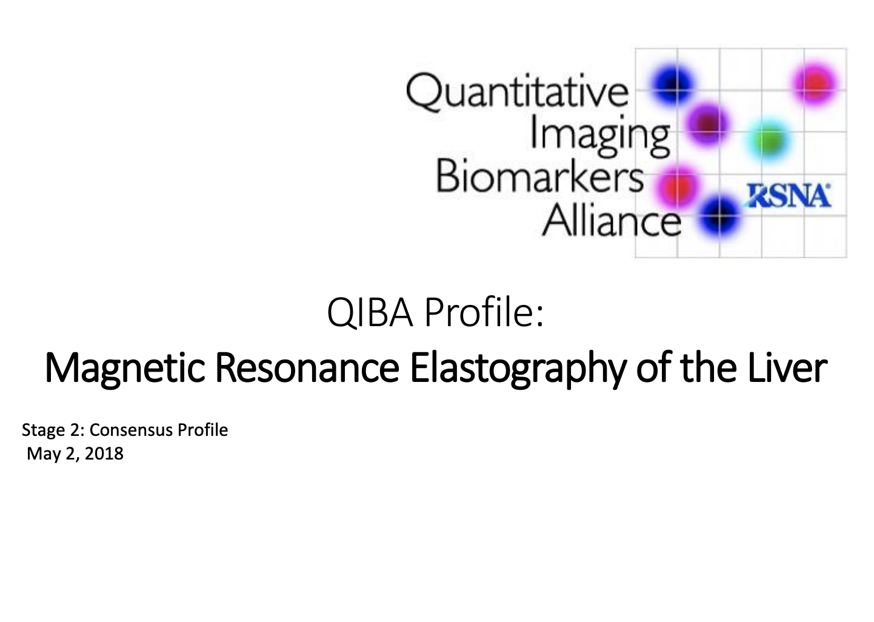
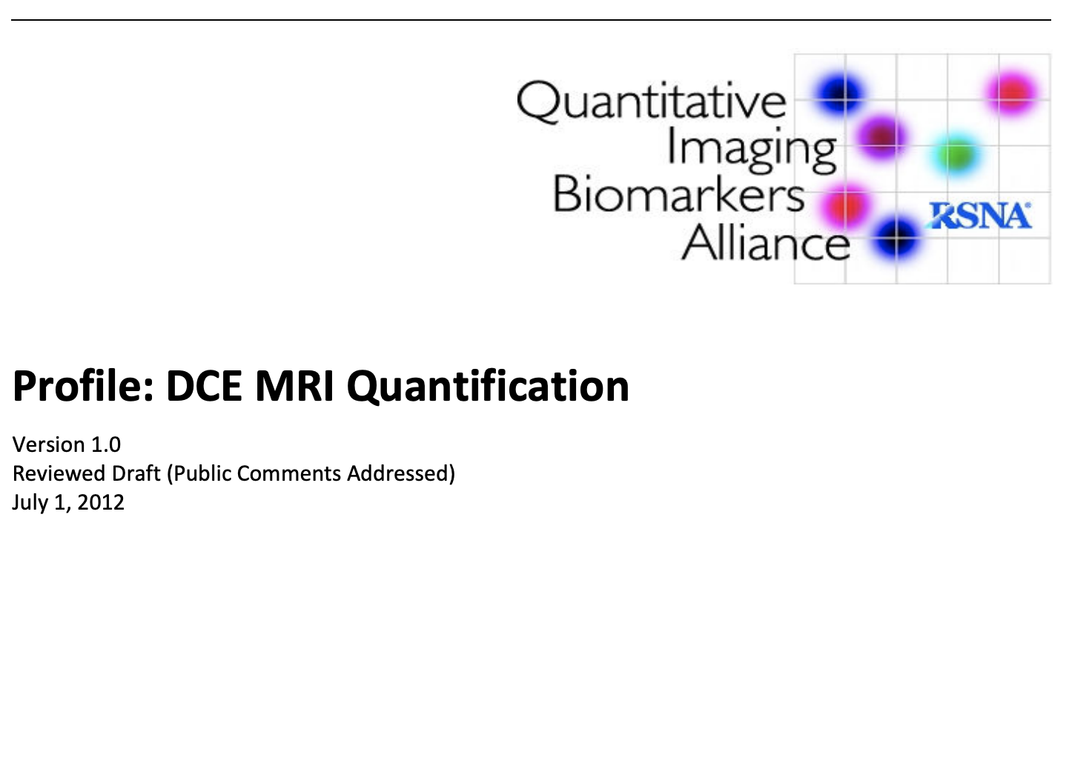
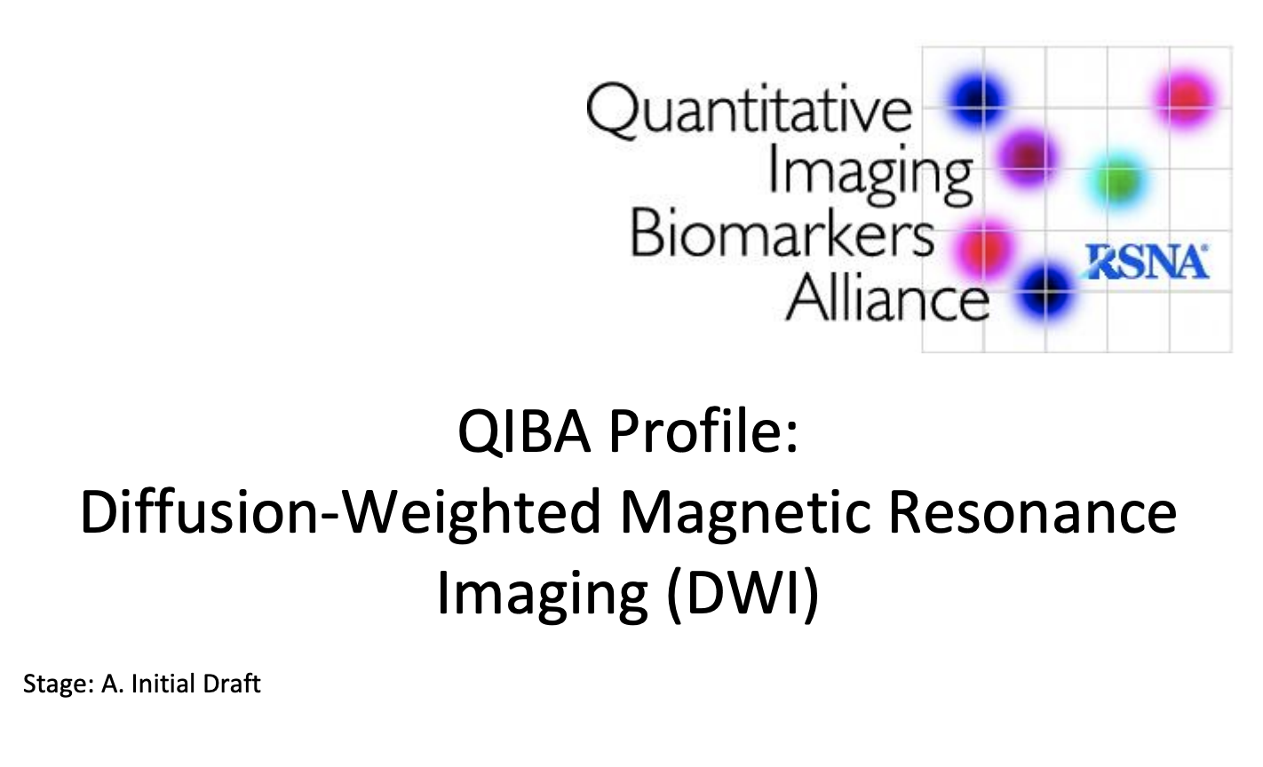
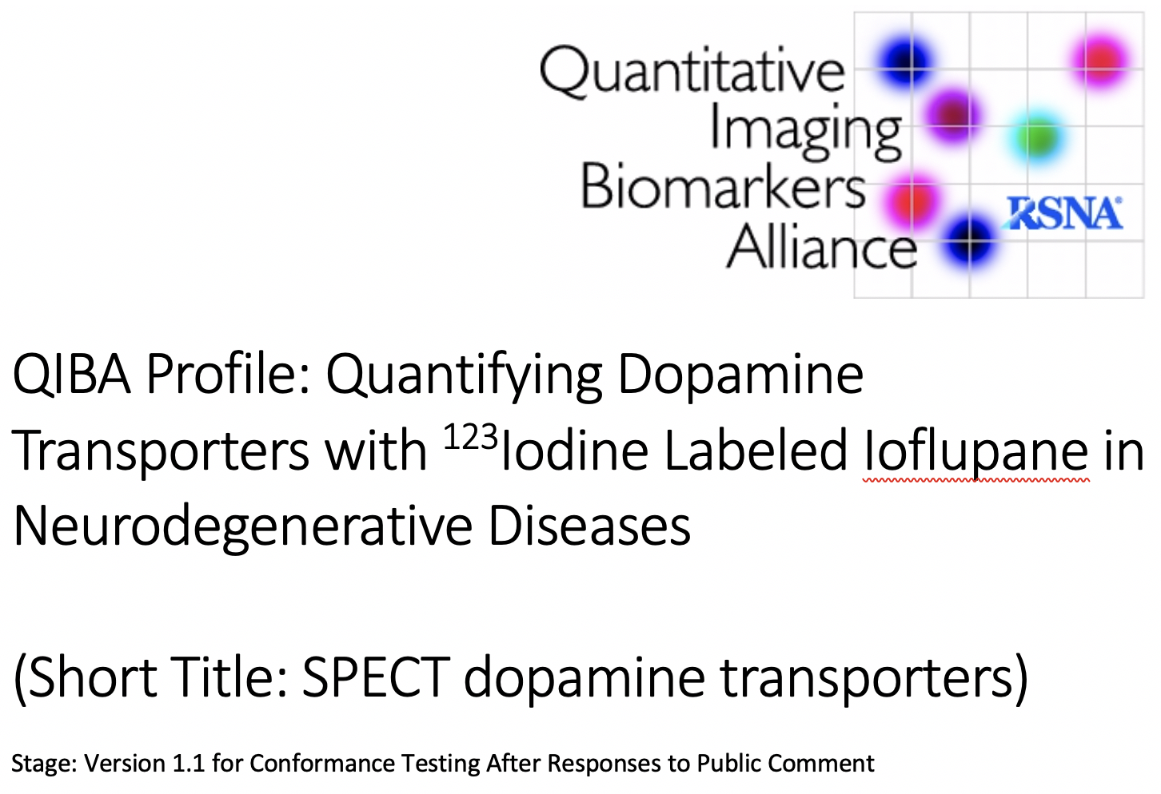
QIBA Deliverables (2)
Profiles (20 total; 5 CT, 3 NM, 9 MR, 3 US*)
*As of 4/26/2019

Slide 5
Current Profile Status (As of 4/8/2019)
20 Profiles (5 CT, 3 NM, 9 MR with 1 on hold, 3 US)
Technically Confirmed Stage and Posted*:
  NM: FDG-PET/CT SUV as an Imaging Biomarker for Measuring Response to Cancer Therapy
  CT: Tumor Volume Change for Advanced Disease
Publicly Reviewed (Consensus) Stage and Posted*:
  CT: Lung Nodule Volume Assessment & Monitoring in Low Dose CT Screening Quantification
  NM: Quantifying Dopamine Transporters with ¹²³Iodine-labeled Ioflupane in Neurodegenerative Disease (SPECT)
  NM: ¹⁸F-labeled PET Tracers Targeting Amyloid as an Imaging Biomarker
  MR: MR Elastography of the Liver
  MR: DCE-MRI Quantification (v1.0) for tumor response
In Public Comment and Resolution Stage:
  MR: DW-MRI for tumor response
  MR: fMRI for pre-surgical planning
  CT: Atherosclerosis biomarkers assessment
*rsna.org/qiba
For details: qibawiki.rsna.org

Slide 6
Current Profile Status (As of 4/8/2019)
In Final Stage of Development for Public Comment Release:
  CT: Lung densitometry for COPD
  US: Ultrasound shear wave speed for liver fibrosis
  MR: Proton density fat fraction (PDFF) for liver disease
In Earlier Stages of Development:
  CT: Tumor volume change for liver lesions
  MR: Dynamic susceptibility contrast (DSC)-MRI for perfusion assessment in brain
  MR: Diffusion tensor imaging (DTI) for traumatic brain injury (currently on hold)
  MR: Revised DCE-MRI to address 3T and parallel imaging
  MR: T₂ and T_{1ρ} MSK MR for degenerative joint disease
  US: Contrast-enhanced ultrasound (CEUS) for perfusion studies
  US: Ultrasound volume flow for perfusion studies – collaboration with AIUM
  MR: Arterial spin labeling (ASL) MR – collaboration with ESR EIBALL
For details: qibawiki.rsna.org

Slide 7
Profile Stages
Stage Name | Stage Meaning | Stage Criteria
Stage 1 Draft for Public Comment | Biomarker Committee experts have drafted the profile, believe it is practical, and expect it to achieve the claimed performance. | Open issues clearly listed Some groundwork may be ongoing Actor requirements clear & justified Statistical review of profile complete
Stage 2 Consensus | Wide community stakeholder input received and addressed with regard to practicality and expectation of achieving the claimed performance. | Public comments addressed Open issues mostly resolved Recommended procedures tested using groundwork projects
Stage 3 Technically Confirmed | Several sites have implemented the profile, found it to be practical, and expect it to achieve claimed performance. | Procedures implemented at multiple test sites using equipment from multiple vendors Conformance assessment procedures defined
Stage 4 Claim Confirmed | A limited number of sites have implemented the profile and found it achieved the claimed performance | Performance measured at test site Profile Claims achieved at limited number of sites / vendors (≥2 each)
Stage 5 Clinically Confirmed | The profile has been implemented in multiple sites and achieves the claimed performance | Profile Claims achieved in clinical use at multiple sites

Slide 8

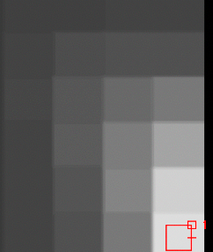
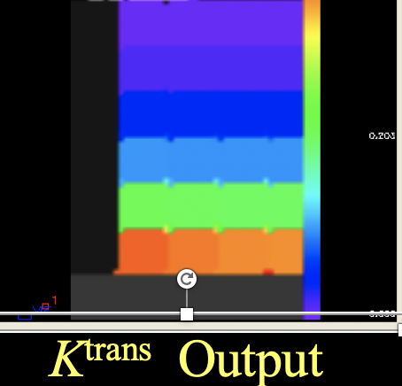
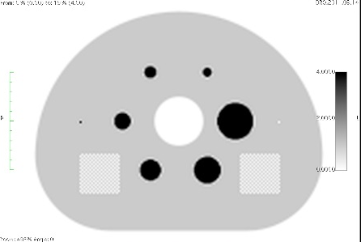
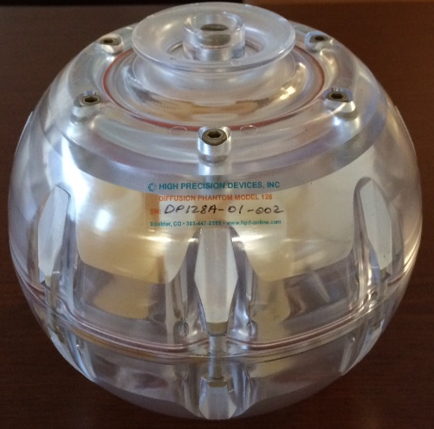
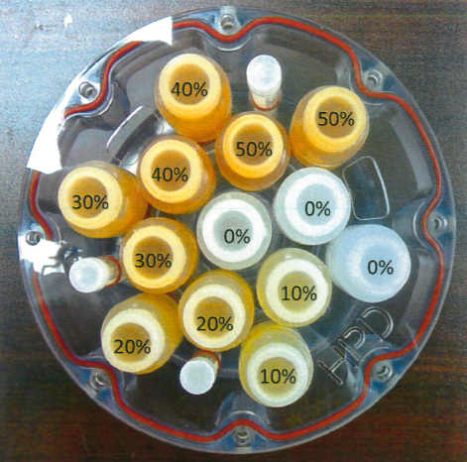
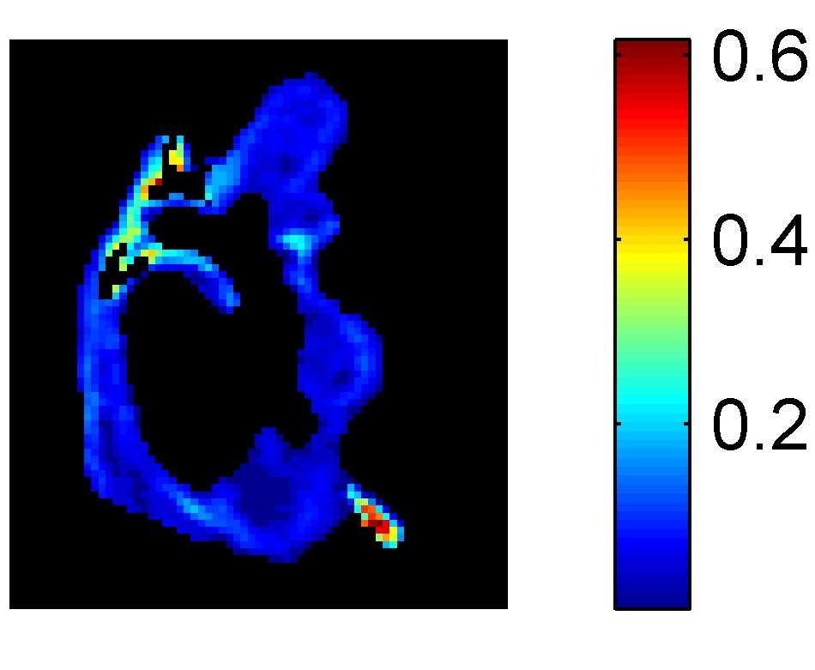
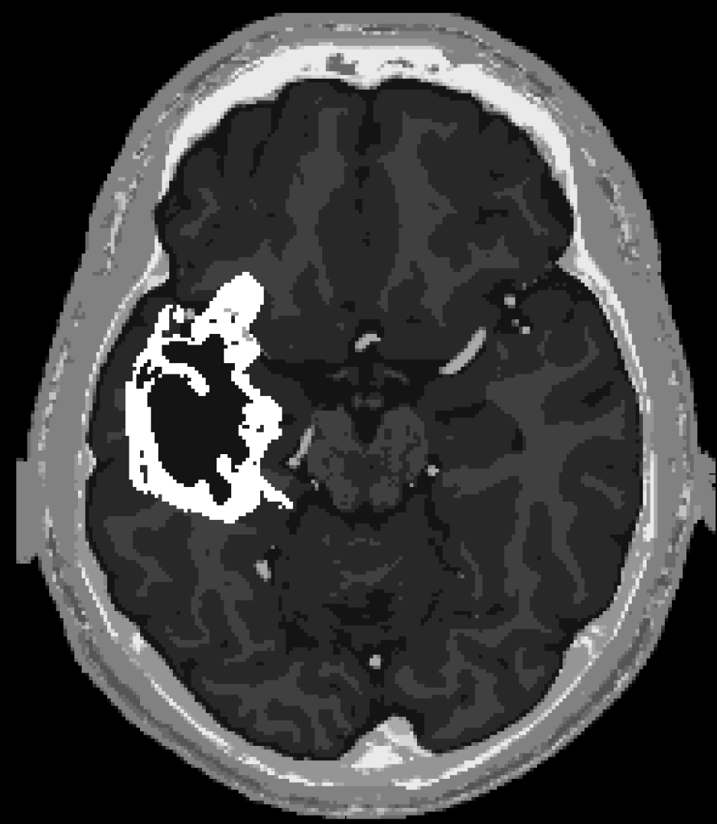
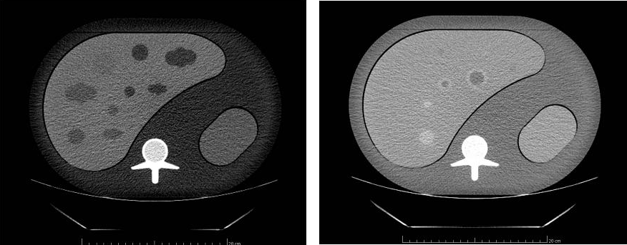
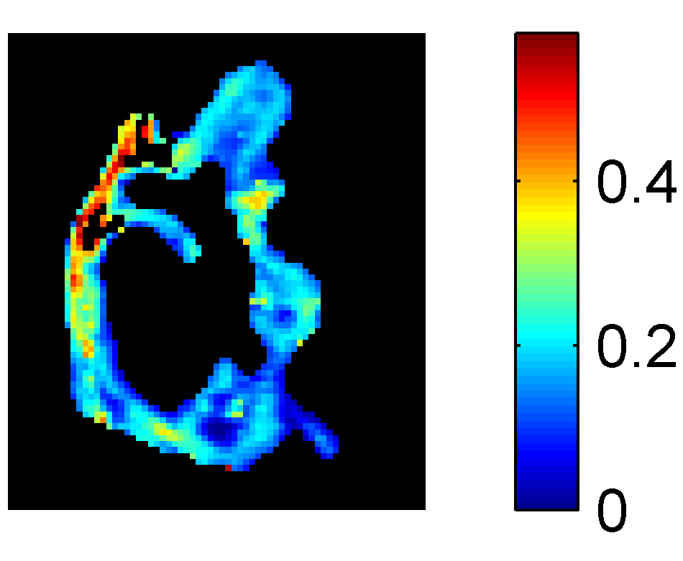
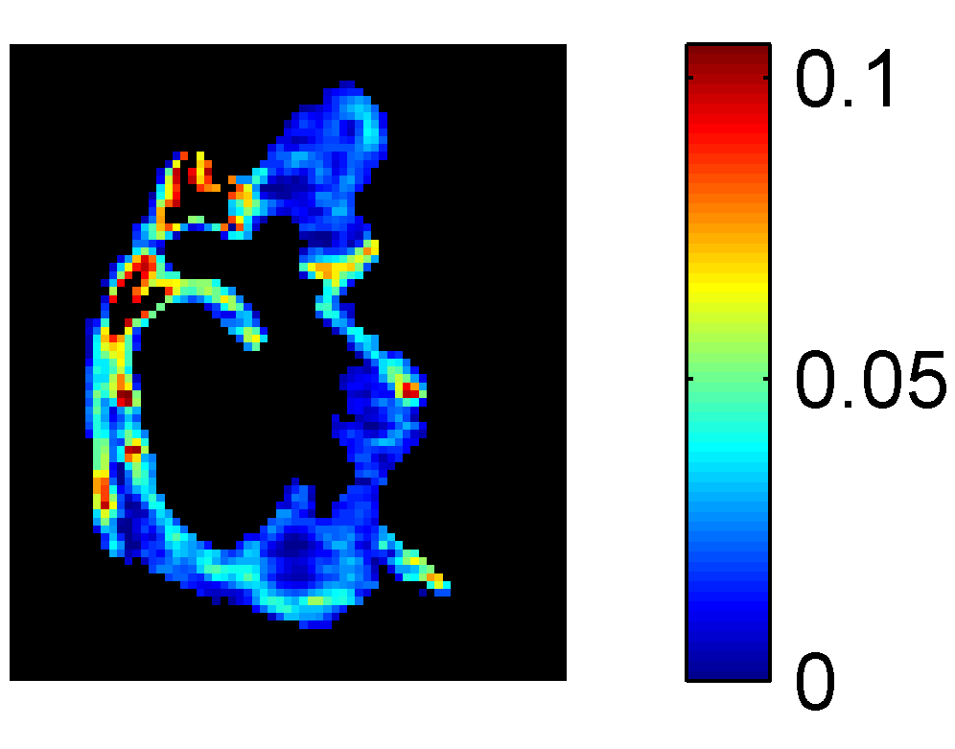
QIBA Deliverables (3)
Phantoms and Analysis Software
V_{e} ===>
NIST-Traceable ADC Phantom
K^{trans} ===>
DCE Digital Reference Object
FDG-PET Digital Reference Object
CT Digital Reference Object
Liver
K^{trans}
Two-Phase Liver CT Volumetric Phantom
v_{e}
Lung
v_{p}
Kidney
DCE-MRI Digital Reference Object
Portal venous phase
Arterial phase

Slide 9
QIBA Phantoms & Datasets
Physical Phantoms (with NIST and FDA)
  Volumetric CT Liver Phantom (arterial/portal venous phase)
  DCE-MRI Phantom and analysis software
  DWI ADC Phantom and analysis software
  DSC-MRI Phantom
  Shear Wave Speed Phantoms (varying viscoelastic properties) – for both US SWS and MRE
Digital Reference Objects (Synthetic Phantoms)
  Volumetric CT DRO (Liver, Lung, Kidney)
  DCE-MRI DRO (T₁ mapping and K^{trans}, v_{e}) and analysis software
  DWI ADC DRO
  DSC-MRI DRO
  fMRI DROs (motor and language mapping)
  PET SUV DRO
  SPECT DRO (¹²³I dopamine transporter, DaTscan/Ioflupane)
Notes:
Physical phantoms (N=5): Conformance assessment and ongoing QC for acquisition devices
DROs (N=7): Conformance assessment and ongoing QC for analysis software

Slide 10
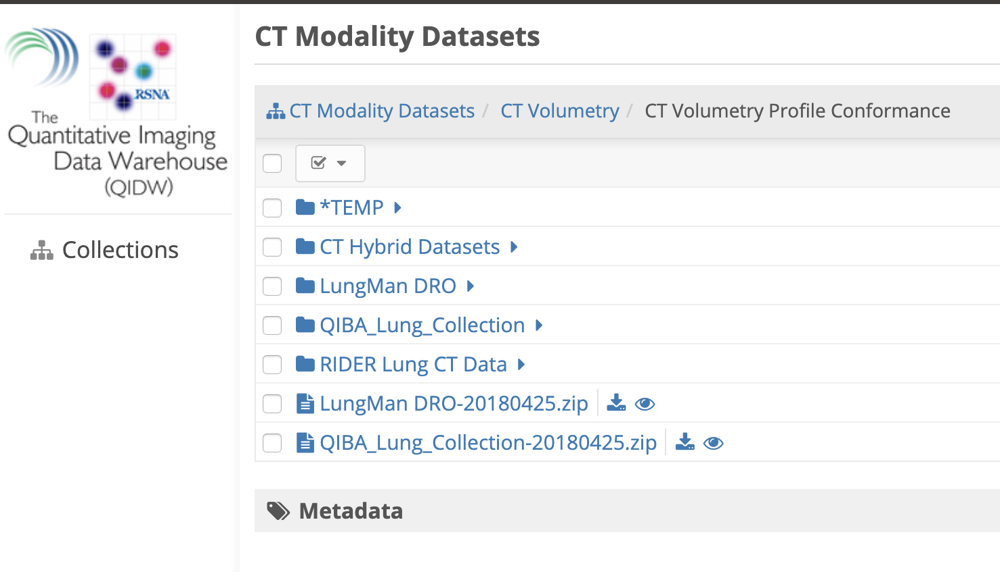
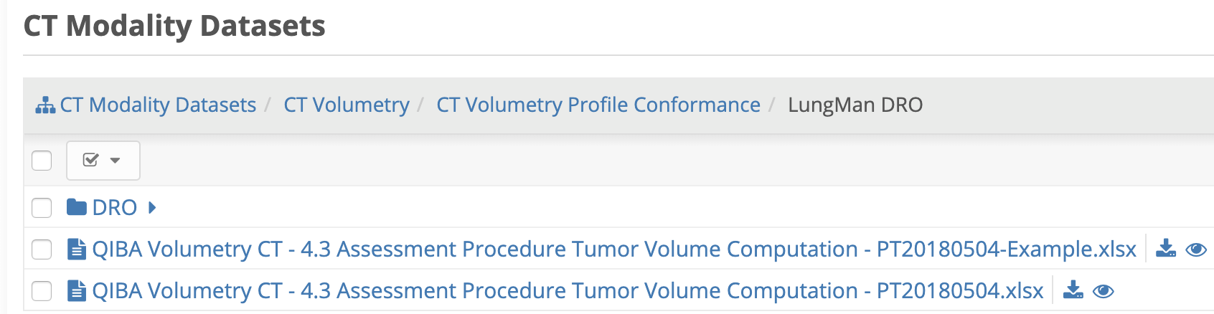
QIBA Phantoms & Datasets
Datasets on QIDW (qidw.rsna.org)
  DROs
  Example physical phantom test data
  Software for analyses of DRO and physical phantom data
  Conformance testing datasets for select Profiles, e.g., CT Volumetry for Advanced Disease
Notes:
Physical phantoms (N=5): Conformance assessment and ongoing QC for acquisition devices
DROs (N=7): Conformance assessment and ongoing QC for analysis software

Slide 11
Adoption of QIBA Products / Concepts
QIBA Profiles adopted in whole or in part in clinical trials (pharma and cooperative trial groups)
Adoption and marketing of “QIBA compliance” by some imaging core labs and software companies
Internationalization of QIBA:
  Active participation from individuals in South America, Europe, and Asia
  EORTC / IMI- and Brazil-QIBA collaborations (MR DWI)
  European Society of Radiology European Imaging Biomarker Alliance (EIBALL)
    First formal QIBA/EIBALL collaboration: MR Arterial Spin Labeling (ASL) Task Force
  Japan Radiological Society (Japan-QIBA)
    Mirrored QIBA structure
    Translation of ~85 page PET/CT SUV Profile
Prevent Cancer Foundation International Community Grants

Slide 12
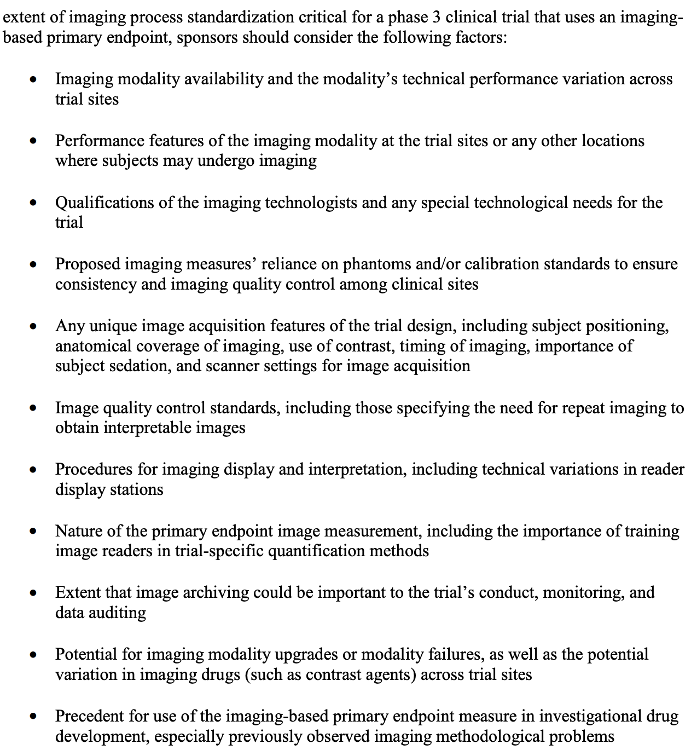

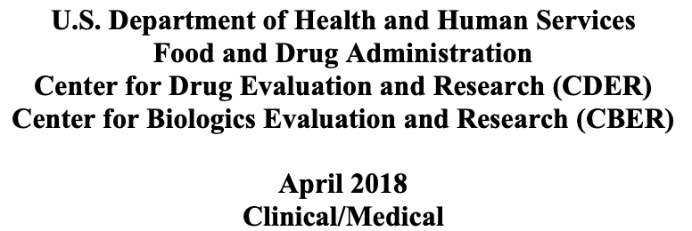
FDA Guidance – Clinical Trial Imaging

Slide 13
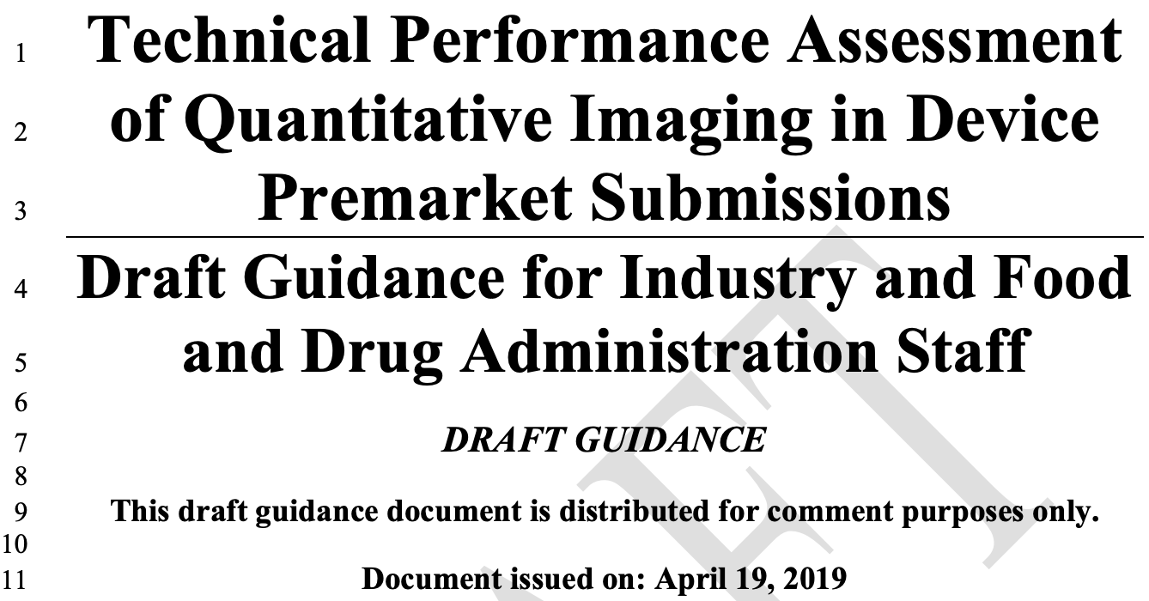
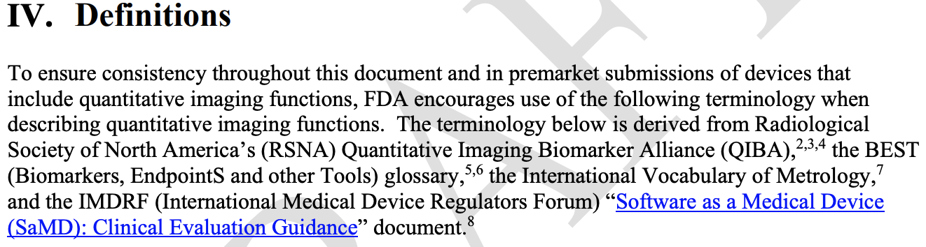
FDA Guidance re: QI

Slide 14
Challenges & Opportunities
Maintaining Momentum => Timely release of deliverables
  Development and release of profiles in a timely manner, i.e., relevance
  Maintain focus on “industrializing QIBs” vs. academic desire for “perfecting QIBs”
  Groundwork project funding for addressing gaps and advancing stage of profiles
Feasibility Testing and Conformance Processes
  Availability of required phantoms, analysis software, and data sets (w/meta data)
  Well-defined feasibility test procedures (parameter space and pass criteria) => “check lists”
  QIDW population of appropriate DROs and data sets, as well as cloud-based analytics, to facilitate conformance validation

Slide 15
Challenges & Opportunities
Field Testing of Profiles
  Realistic goal(s) of field testing of a Technically Confirmed Profile => Claim Confirmed
  Identification of opportunities for collaborations, e.g., ECOG-ACRIN, Alliance, NRG, etc.
Sustainability
  Groundwork projects, profiles, conformance processes, and imaging metrology deliverables
  Diversification of revenue sources beyond RSNA, e.g., pharma
  Partnership with ACR or other accreditation / certification bodies
  Potential development of QIBA “business arm”

Slide 16
QIBA SC Meeting Agenda
Coordinating Committee Reports
  CT
  MR
  NM
  US

Slide 17
QIBA SC Meeting Agenda
External Relations Liaison / International Efforts Updates
  EIBALL
  Japan-QIBA

Slide 18
QIBA SC Meeting Agenda
QIBA Sustainability Implementation Group (SIG) Discussion

Slide 19
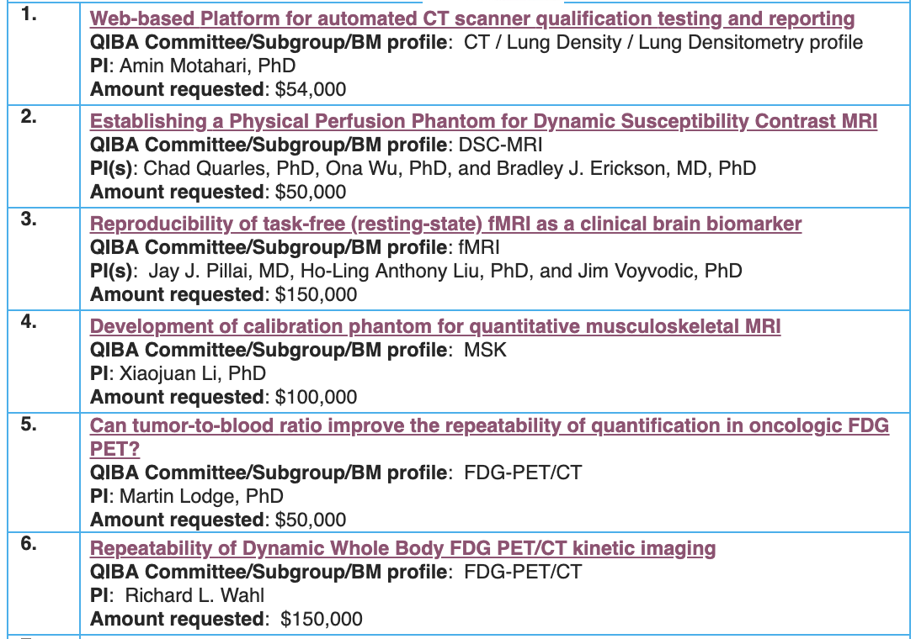
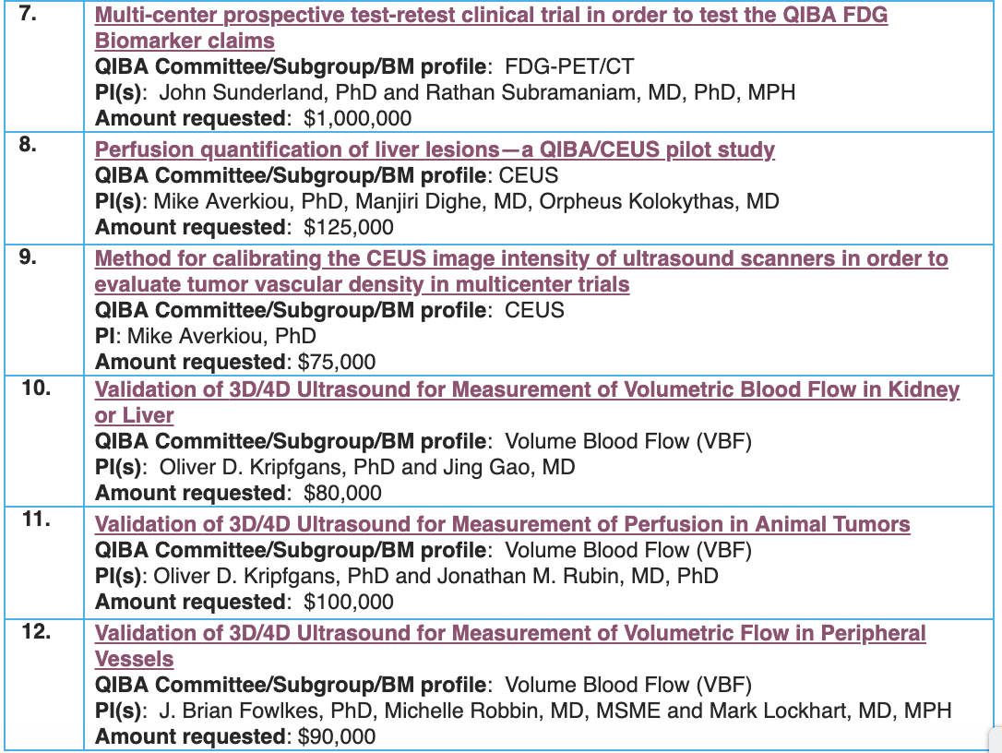
Pending Groundwork Projects

Slide 20
QIBA SC Meeting Agenda
Conformance Assessment – Where We Are Now and Next Steps
Update on Federal Funding Options
Process Committee Report

Slide 21
QIBA SC Meeting Agenda
Other Business
  Optional re-identification of QIBA challenge results
  Proposal from QIBA Leadership
    Creation of a QIBA Executive Committee
      Significant expansion of QIBA scope (BCs/TFs, SIG, Metrology, etc.)
      Goal of streamlining Steering Committee efforts, respectful of time
    Proposed monthly meeting of Exec Cmte and quarterly meeting of full Steering Cmte (maintaining current 3rd Thursday time slot)
    Exec Cmte membership: Chair and Vice Chair, 1 rep from each CC, statistician (Obuchowski), External Liaison (Sullivan), Process Cmte Chair (O’Donnell), SIG Chair (Zahlmann), NCI CIP rep

