Slide 1
QIBA Sustainability Implementation Group (SIG) Update
QIBA Annual Meeting
Wednesday, June 12, 2019

Slide 2
QIBA Sustainability Task Force Results – May 2018
Short-term
Grants
Foundation
Philanthropy
Medium-term
Pay for use of QIDW data
Long-term (accreditation / certification)
Site, Data, Analysis Certification
Image Data Certification – QIBA “Stamp”
Site Qualification – QIBA “Stamp”
CRO Qualification

Slide 3
Why Form a Sustainability Implementation Group?
Sustainability Task Force results needed implementation
Small, focused working group to drive business side of QIBA
SIG started in September 2018
SIG members:
Annette Schmidt, Anne Smith, Dan Sullivan, Ed Jackson, Alex Guimaraes, Rich Wahl, Gudrun Zahlmann

Slide 4
QIBA Sustainability Implementation
May 2018
June 2019
QIBA External Funding
QIBA External Funding
Short-term
Grants
Foundation
Philanthropy
Medium-term
Pay for use of QIDW data
Long-term (accreditation / certification)
Site, Data, Analysis Certification
Image Data Certification – QIBA Stamp
Site Qualification – QIBA Stamp
CRO Qualification
Short-term
Grants: ongoing activity QIBA leadership
Letter to Pharma: accepted by QIBA SC + RSNA; distribution list in review; to be out end of June 2019
Philantrophy: additional models under discussion
Short to Medium-term
Business concept :
Pay for use of QIDW data
Pay for QIBA conformance attestation / certification of all relevant actors as described in QIBA profile conformance tables
Site conformance
CRO/imaging corelab conformance
Vendor (HW, SW) conformance
Concept confirmed by QIBA SC and RSNA Board
Business plan v0.1 available
QIBA Business
QIBA Business

Slide 5
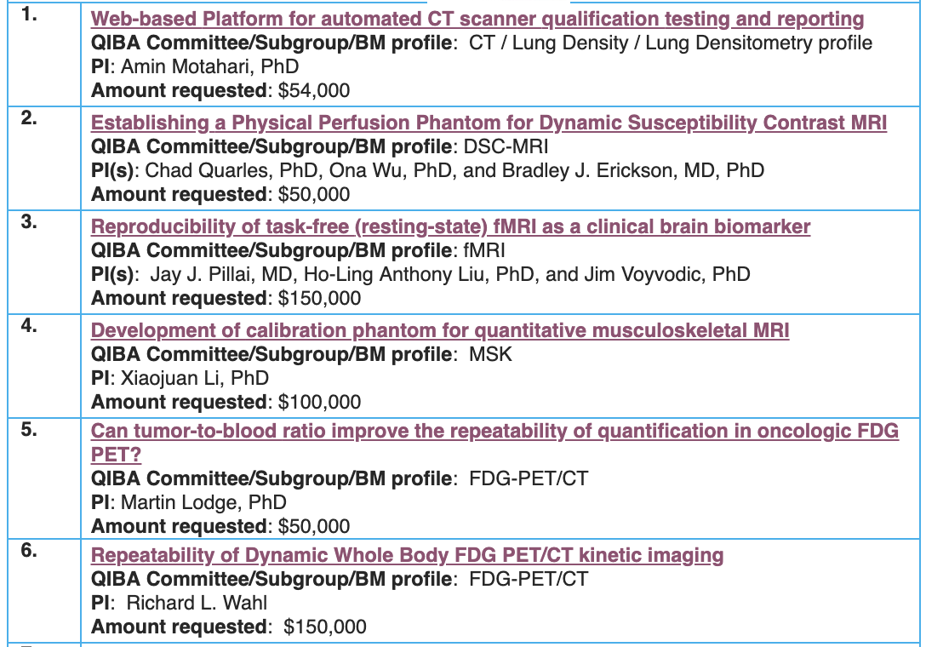
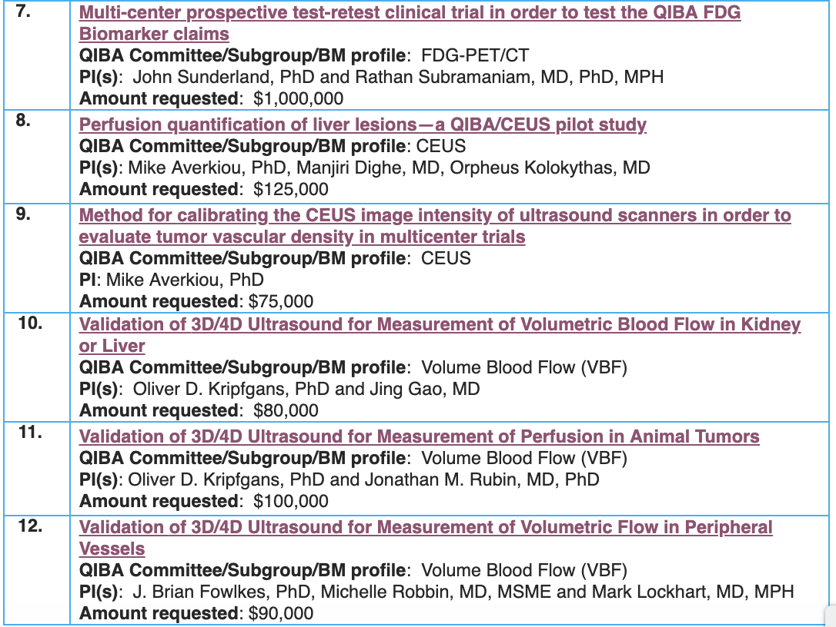
SIG – Current / Next Activities Pharma Request – Example Groundwork Projects

Slide 6
SIG – Current / Next Activities
Work with QIBA leadership and RSNA staff to distribute letter to pharma
Business Plan
3 selected QIBs (SUV, ADC, CT vol advanced disease) as ‘pilots’ to:
Translate profile conformance tables into procedures / manuals for all relevant actors
Define test report content
Define who from QIBA would be responsible for data assessment and decisions on QIBA conformance
Test usability of process for self-attestation and certification as described in Business Plan
Target Timeline: First round ready by end of 2019
Adjust business plan
Prepare for first conformance testing with selected companies
Continue collaboration with Accumetra on site certification
Marketing
Update QIBA web presence on respective activities (update conformance testing, brochure, online information, etc.)

Slide 7
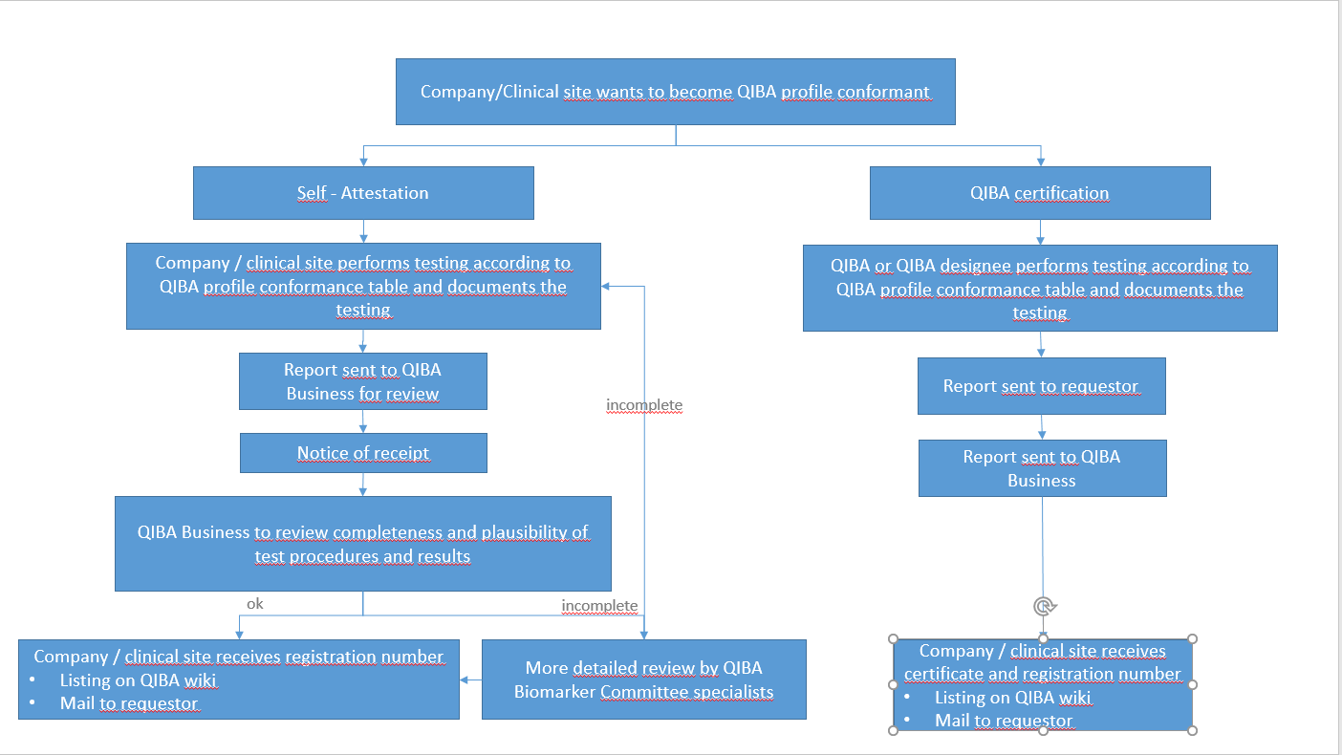
QIBA Profile Conformance Testing

Slide 8
Example DWI (DWI ADC Profile)
Certification Model Pilot:
Profile has sufficient status
Conformance table available for different actors
There is already pre-work by UMichigan in form of:
Site manuals
Scanning instructions for phantoms and patients for different organs of interest
Communication pathway re: how sites submit images plus metadata to UMichigan
Analysis process and tools are available
Report content (what to communicate back to a site) is available
A dedicated phantom is available and can be purchased
Dedicated and motivated personnel are available for first testing/certification steps
Result of first discussion: Tom Chenevert, Michael Boss, Gudrun Zahlmann

Slide 9
Additional Pilots
Self-attestation model: FDG PET SUV Profile
Certification model: CT Volumetry for Advanced Disease
Accumetra Small Lung Nodule Profile (ongoing)

