Slide 1
QIBA Sustainability Implementation Group (SIG) Update
Steering Committee Meeting
Tuesday, June 11, 2019

Slide 2
QIBA Sustainability Task Force Results May 2018
Short-term
Grants
Foundation
Philanthropy
Medium-term
Pay for use of QIDW data
Long-term (accreditation / certification)
Site, Data, Analysis Certification
Image Data Certification – QIBA Stamp
Site Qualification – QIBA Stamp
CRO Qualification

Slide 3
Why Sustainability Implementation Group?
Sustainability Task Force results need implementation
Agile, small working group
To drive business side of QIBA
SIG started September 2018
SIG members:
Annette Schmidt, Anne Smith, Dan Sullivan, Ed Jackson, Alex Guimaraes, Rich Wahl, Gudrun Zahlmann

Slide 4
QIBA Sustainability Implementation
May 2018
June 2019
QIBA External funding
QIBA External funding
Short-term
Grants
Foundation
Philanthropy
Medium-term
Pay for use of QIDW data
Long-term (accreditation / certification)
Site, Data, Analysis Certification
Image Data Certification – QIBA Stamp
Site Qualification – QIBA Stamp
CRO Qualification
Short-term
Grants ongoing activity QIBA leadership
Letter to Pharma : accepted by QIBA SC + RSNA; distribution list in review; to be out end of June 2019
Philantrophy: additional models under discussion
Short to Medium-term
Business concept :
Pay for use of QIDW data
Pay for QIBA conformance attestation / certification of all relevant actors as described in QIBA profile conformance tables
Site conformance
CRO/imaging corelab conformance
Vendor (HW, SW) conformance
Concept confirmed by QIBA SC and RSNA Board
Business plan v0.1 available
QIBA Business
QIBA Business

Slide 5
SIG – current/next activities
Work with QIBA leadership and RSNA staff to distribute letter to pharma
Business Plan
3 selected QIBs (SUV, ADC, CT vol advanced disease) as ‘pilots’ to:
Translate profile conformance tables into procedures/manuals for all relevant actors to do conformance testing
Define test report content
Define who from QIBA would do report/data assessment for decision on QIBA conformance
Test usability of process for self-attestation and certification as described in Business plan – adjust as needed
Timeline: first round ready by end of 2019
Adjust business plan
Get us ready for first conformance testing with selected companies
Continue collaboration with Rick Avila on site certification
Marketing
Update QIBA web presence on respective activities in parallel to result generation (update conformance testing, brochure online version etc.)

Slide 6
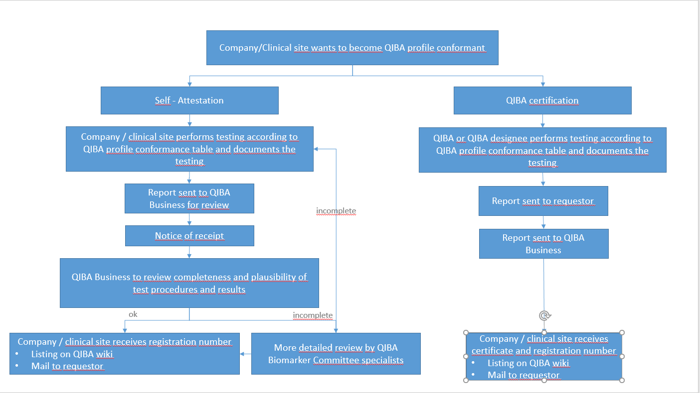
QIBA Profile Conformance Testing

Slide 7
Example DWI (ADC)
Prerequisites:
Profile has sufficient status
Conformance table available for different actors
There is already pre-work by Chenevert in form of:
Site manuals
Scanning instructions for phantoms and patients for different organs of interest
Communication pathway re: how sites send images plus metadata to UMichigan
Analysis process and tools are available
Report content (what to communicate back to a site) is available
A dedicated phantom is available and can be purchased
Dedicated and motivated personnel are available for first testing/certification steps (Tom, Michael, Gudrun)
Result of first discussion Tom Chenevert, Michael Boss, Gudrun Zahlmann

Slide 8
Example DWI (ADC)
What is next?
Discussion about status and missing details during Annual meeting (Tom, Michael)
Review of available material and solutions with regard to usability for QIBA conformance (Tom, Michael, Gudrun)
Setup of a first solution to conformance testing of an imaging vendor – currently discussed solution is a QIBA certification procedure. Self attestation needs further discussion. Experience for clinical site assessment is certification as well.
As of today, the business concept seems to work out for ADC – needs implementation.
Image and report ‘communication‘ via QIDW and e-mail – ‘semi-automatic‘ solution, but seems to enable a quick start without additional infrastructure developments – needs to be checked.
Result of first discussion Tom Chenevert, Michael Boss, Gudrun Zahlmann

Slide 9
What about the other two QIBs?
First call with pilot drivers of all three QIBs
Continue discussion as for ADC at Annual meeting
Wrap up and next steps discussed by end of June in QIB-specific calls
Discussion in SIG about findings/learnings and adjustment of Business plan and business process as needed. Decision when next discussion with RSNA is needed.

Slide 10
Thank you
To Annette, Anne, Rich, Dan, Ed and Alex for their efforts and great contributions
To all QIB committees that supported SIG by providing project proposals
To RSNA staff for all the great support !

Slide 11
Backup

Slide 12
Activities of SIG
What | Who | Status 6/5
Write letter to pharma companies for donation | Ed/Gudrun | Ready for sending out Letter and attached project proposals Discussed with all relevant stakeholders List of addressees under review
Provide language for image purchase decision makers in clinical care regarding importance of QIBA conformance | Rich | Available Distribution list and mode of contact in discussion with RSNA and QIBA leadership
QIN grant follow up | Dan/Ed/Alex Other QIBA working group | Ongoing activity
Start business plan development | Ed/Gudrun/Rich/Anne | Concept confirmed Prepare self-attestation and certification processes and report by end of 2019 Close contact to and learning from Accumetra pilot
Provide flyer with basic information on QIBA Business services | Gudrun/Ed | Available in QIBA locations at RSNA Annual Meeting 2018

Slide 13
QIBA Business – basic idea
Business idea: To prove QIBA profile conformance for individual or all parts of a profile
QIBA profile
Conformance listings
Self attestation of profile conformance
QIBA or designee tests for conformance
QIBA registered
QIBA certified

Slide 14
QIBA Business – basic idea
QIBA Registered | QIBA Certified
Interested party sends conformance document based on self-testing to QIBA Business arm management. QIBA Business arm management confirms appropriate self-testing of QIBA profile conformance by an interested party. Successful applicants receive a letter of acceptance of self-testing and a QIBA Registration number. All QIBA Registered solutions of interested parties are listed on the QIBA wiki. QIBA Certification costs xxx (see price list). QIBA Registration number is valid for one year starting with registration date. | QIBA Certified level is based on conformance testing by QIBA members or by a QIBA-approved third party of a solution provided by an interested party. QIBA Certified is the higher level conformance approval. QIBA Certificates are published at the QIBA wiki. Successful applicants for QIBA Certified level receive a QIBA conformance certificate and a registration number. QIBA Certification costs xxx (see price list). A QIBA Certificate is valid for 1 year starting with the certification date.

