Slide 1
The Quantitative Imaging Biomarkers Alliance (QIBA®)
Edward F. Jackson, PhD – Chair, QIBA
Professor and Chair, Department of Medical Physics
University of Wisconsin School of Medicine & Public Health
Part I
July 22, 2016

Slide 2
Quantitative Imaging Biomarkers
Biomarkers are characteristics that are objectively measured and evaluated as an indicator of normal biologic processes, pathogenic processes, or pharmacologic responses to a therapeutic intervention.¹
Quantitative imaging biomarkers (QIBs) are objective characteristics derived from in vivo images as indicators of normal biological processes, pathogenic processes, or response to a therapeutic intervention.²
¹NIH Biomarkers Definitions Working Group, Clin Pharmacol Therap 69(3):89-95, 2001
²Sullivan et al., Radiology 277(3):813-825, 2015 (www.rsna.org/qiba)

Slide 3
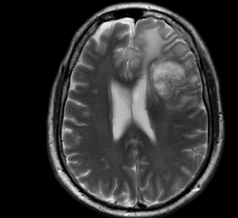
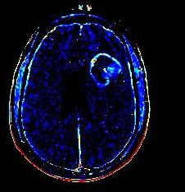
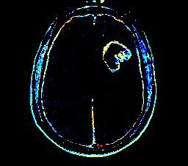
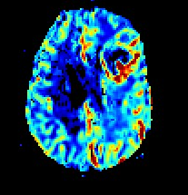
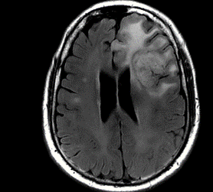
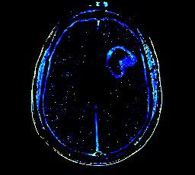
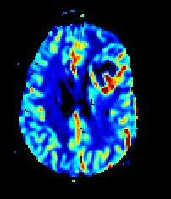
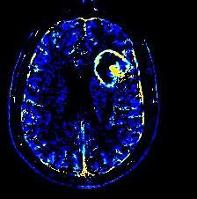
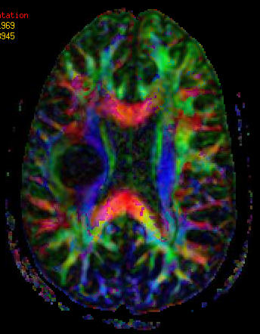
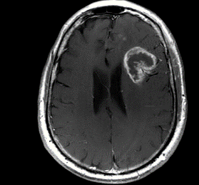
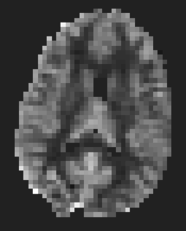
Example MR QIB Applications
Existing MR QIBs:
From simple morphological to numerous functional measures
DWI
ADC
K^{trans}
k_{ep}
rCBV
T2
v_{p}
v_{e}
rCBF
BOLD fMRI
DTI FA
T2FLAIR
ASL CBF
T1+Gd

Slide 4
Consumer Expectations for Quantification
94% of oncologists expect some or all tumors to be measured at the time of standard initial clinical imaging. (Jaffe T, AJR 2010)
Neurologists and psychiatrists desire quantitative measures of brain disorders (IOM Workshop, August 2013).
Pulmonologists desire CT-derived quantitative measures in COPD and asthma patients. (ATS/ERS Policy statement, Am J Resp Crit Care Med 2010)
Hepatologists desire quantitative measures of liver fat infiltration (Fitzpatrick E, World J Gastro 2014)
Rheumatologists desire quantitative measures of joint disease (Chu C, JBJS:J Bone Joint Surg 2014)
U.S. regulatory agencies (e.g., FDA) desire more objectivity in imaging scan interpretations.
Source: Daniel C. Sullivan, MD
Notes:
ATS: American Thoracic Society
ERS: European Respiratory Society

Slide 5
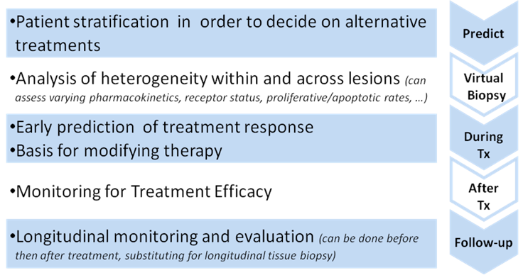
QIBs in Precision Medicine
Buckler, et al., A Collaborative Enterprise for Multi-Stakeholder Participation in the Advancement of Quantitative Imaging, Radiology 258:906-914, 2011

Slide 6
Quantitative Imaging
In addition:
Evidence-based medicine and QA programs depend on objective data
Decision-support tools need quantitative inputs
Radiomics and radiogenomics studies require quantitative data
P. Lambin et al. Eur J Cancer 48:441-446 2012

Slide 7
QIB Challenges
Diagnostic Imaging Equipment ≠ Measurement Device
Measurement Device:
Specific measurand(s) with known bias and variance (confidence intervals)
Specific requirements for reproducible quantitative results
Example: a pulse oximeter
Diagnostic Imaging Equipment:
Historically: best image quality in shortest time (qualitative)
No specific requirements for reproducible quantitative results (with few exceptions)

Slide 8
QIB Challenges
General QIB challenges:
Lack of detailed assessment of sources of bias and variance
Lack of standards (acquisition, analysis, and reporting)
Highly variable quality control procedures
QC programs / phantoms, if any, typically not specific for quantitative imaging
Little support (historically) from imaging equipment vendors
No documented competitive advantage of QIB (regulatory or payer)
All lead to varying measurement results across vendors, centers, and/or time

Slide 9
QIB Challenges
General QIB challenges:
Cost of QIB studies (comparative effectiveness) / reimbursement
Resource availability
Technologists are not trained in advanced, quantitative, protocols
Potential shortage of imaging scientists, data processing capabilities, etc.
Radiologist acceptance
QIBs are not part of radiologist education & training
Lack of guidelines for QIB reporting
Software and workstations needed to calculate and interpret QIB measures are not integrated into the radiologist’s workflow
Clinical demand on radiologists is high --- “time is money”

Slide 10
QIB Challenges
QIB Implementation and Qualification
Data acquisition => Need for physical phantoms
Application specific (potentially including human subjects)
Data analysis => Need for synthetic phantoms
“Digital reference objects” or DROs
Application specific and, ideally, anthropomorphic
Qualification => Need for clinical trials

Slide 11
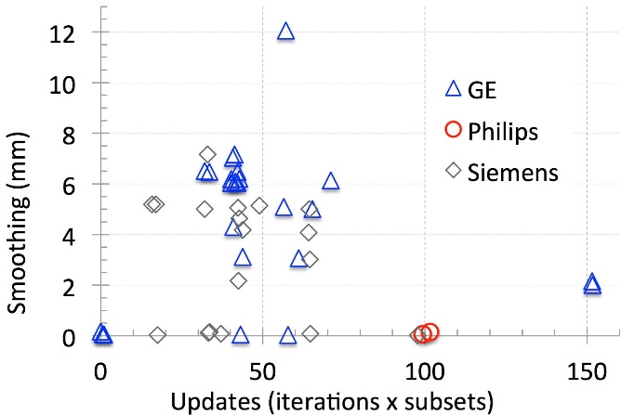
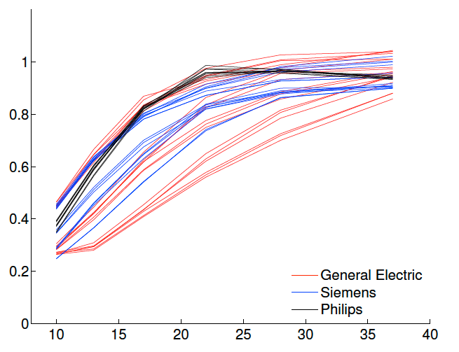
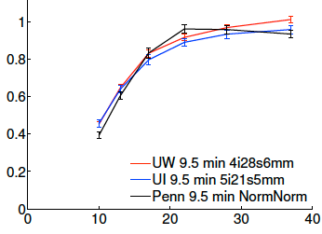
PET Reconstruction Harmonization
RC
RC
Vendor A
Vendor B
Vendor C
Vendor A
Vendor C
Vendor B
Diameter (mm)
Diameter (mm)
Sample of reconstruction settings from 68 academic centers
Range of biases as a function of object size (1.0 is no bias) for different reconstruction settings
Harmonized results
Source: Paul Kinahan, PhD
University of Washington
RC = Ratio of Observed Activity Concentration to Actual Activity Concentration

Slide 12
Poor Reproducibility has Clinical Implications
Willemink MJ, et al. Coronary artery calcification scoring with state-of-the-art CT scanners from different vendors has substantial effect on risk classification. Radiology 173:695-702, 2014
“Among individuals at intermediate cardiovascular risk, state-of the-art CT scanners made by different vendors produced substantially different Agatston scores, which can result in reclassification of patients to the high- or low-risk categories in up to 6.5% of cases.”
Oberoi S, et al. Reproducibility of noncalcified coronary artery plaque burden quantification from coronary CT angiography across different image analysis platforms. AJR Am J Roentgenol 202:W43-9, 2014
“Currently available noncalcified plaque quantification software provides …poor interplatform reproducibility. Serial or comparative assessments require evaluation using the same software. Industry standards should be developed to enable reproducible assessments across manufacturers.”
Source: Daniel C. Sullivan, MD

Slide 13
Adopting Metrology Principles in Imaging
Sources of bias and variance in QIB measurands are identified and mitigated to the degree possible.
Bias* (accuracy):
Often difficult to assess due to absence of reference standard (“ground truth”) measures
Need application-specific phantoms
Precision* (variance):
Repeatability* – All conditions the same except short time separation (“test/retest”)
– Repeatability coefficient
Reproducibility* – Different operators, different days, etc.
– Reproducibility coefficient
*Kessler, Barnhart, et al., Stat Meth Med Res 24:9-26, 2015; Sullivan, Obuchowski, et al. Radiology 277:813-825, 2016
available at www.rsna.org/qiba

Slide 14
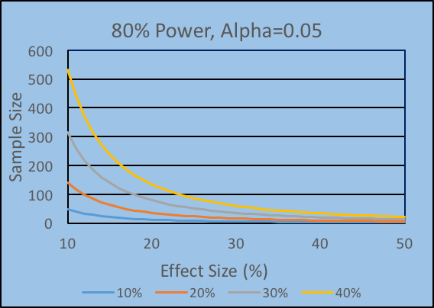
Adopting Metrology Principles in Imaging
Levels of bias and variance remaining after mitigation are characterized => confidence intervals.
Knowing these levels translates to statistically valid study designs with adequate power and the fewest number of patients.
Number of patients:
10% 12
20% 35
30% 78
40% 133

Slide 15
RSNA QIBA
QIBA was initiated in 2007 under the leadership of Dan Sullivan
RSNA Perspective: One approach to reducing variability in radiology is to extract objective, quantitative results from imaging studies.
QIBA Mission
Improve the value and practicality of quantitative imaging biomarkers by reducing variability across devices, patients, and time.
“Industrialize imaging biomarkers”

Slide 16
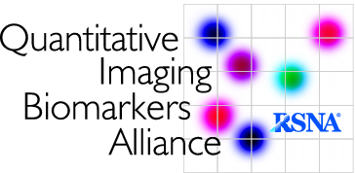
Qualitative Imaging => Biomarker Assays
Assays are characterized by their:
Technical Performance
Clinical Performance
Clinical validation
Clinical utility

Slide 17
RSNA QIBA Approach
- Transformational: addresses gaps, impacts public health
- Translational: concept proved, ready to advance
- Feasible: good change to succeed in near term
- Practical: leverages existing resources and technology
- Collaborative: engages HW/SW/agent stakeholders
Select a Biomarker
Academic Use
- Identify significant sources of bias and variance
- Estimate achievable accuracy and precision
- Validate underlying assumptions and mechanisms
- Determine details to specify in the Profile
Coordinate Groundwork
Clinical Trial Use
- Define claim (cross-sectional and/or longitudinal) and clinical context
- Specify details necessary for robust implementation
- Make details clear, implementable, and testable
- Define conformance criteria for each “actor” in imaging chain
Draft QIBA Profile
Clinical Practice Use
Validate Equipment & Sites
- Test conformance with QIBA Profile specifications
- Publish validated products and sites
Buckler, et al., A Collaborative Enterprise for Multi-Stakeholder Participation in the Advancement of Quantitative Imaging, Radiology 258:906-914, 2011

